Slide 1
A Performance Evaluation of Azure and Nimbus Clouds for Scientific Applications
Joint work with
Alexandru Costan, Gabriel Antoniu, Luc Bougé
Radu Tudoran
KerData Team
Inria Rennes
ENS Cachan
10 April 2012

Slide 2
Outline
Context and motivation
2 cloud environments: Azure and Nimbus
Metrics
Evaluation and discussions
Conclusion

Slide 3
Scientific Context for Clouds
Up to recent time, scientists mainly relied on grids and clusters for their experiments
Clouds emerged as an alternative to these due to:
Elasticity
Easier management
Customizable environment
Experiments’ repeatability
Larger scales
Notes:
Cloud is not the universal panacea…hence it is not perfect for all scientific apps. Some of them require specialized hardware (HPC, SuperComputers). Clouds are built on commodity hardware….
De inlocuit cu poze ….

Slide 4
Requirements for Science Applications
Performance: throughput, computation power, etc.
Control
Cost
Stability
Large storage capacity
Reliability
Data access and throughput
Security
Intra-machine communication

Slide 5
Stages of a Scientific Application
Computation Nodes
1
Local Host
4
5
3
2
Cloud Storage
6

Slide 6
Public Clouds: Azure
On demand – pay as you go
Computation (Web/Worker Role) separated from storage (Azure BLOBs)
HTTP for storage access
BLOB are structured in containers
Multitenancy model
VM Type | CPU Cores | Memory | Disk
Small | 1 | 1.75GB | 225GB
Medium | 2 | 3.5GB | 490GB
Large | 4 | 7GB | 1000GB
ExtraLarge | 8 | 14GB | 2040GB
VM Characteristics

Slide 7
Private Nimbus-powered Clouds
Deployed in a controlled infrastructure
Allows to lease a set of virtualized computation resources and to customize the environment
2 Phases deployment:
- The cloud environment
- The computation VMs
Cumulus API
- allows multiple storage
- quota based storage
- VM image repository
Notes:
– only VM deployment in Public Clouds
Cumulus traditionally stores the VMs

Slide 8
Focus of Our Evaluation
Initial phase
- Deploying the environment (hypervisors , application, etc.)
- Data staging
- Metric: Total time
Applications’ Performance and Variability
Computation - Real application ABrain
- Metric: Makespan
Data transfer - Synthetic benchmarks
- Metric: Throughput
Cost
- Pay-as you go
- Infrastructure & Maintenance
Notes:
First step…although is always present, it does not appear in the literature!

Slide 9
Pre-processing
Deployment time - Azure – 10 – 20 minutes
- Nimbus - Phase 1 – 15 minutes
- Phase 2 – 10 minutes (on Grid5000)
Data moved from Local to Cloud Storage

Slide 10
Pre-processing (2)
Data moved from Cloud Storage to Computing nodes

Slide 11
Pre-processing
Deployment time - Azure – 10 – 20 minutes
- Nimbus - Phase 1 – 15 minutes
- Phase 2 – 10 minutes (on Grid5000)
Size GB | Azure |  | Nimbus
 | Local->AzureBlobs | AzureBlobs->Local | Local->Cumulus | Cumulus->Local
0,1 | 16 | 12 | 12 | 13
1 | 130 | 90 | 92 | 107
10 | 1288 | 1176 | 769 | 854
100 | 13207 | 10409 | 8152 | 8798
Data moved from Local to Cloud Storage
Size GB | Azure |  | Nimbus
 | ExtraLarge->AzureBlobs | AzureBlobs->ExtraLarge | VM->Cumulus | Cumulus->VM
0,1 | 17 | 13 | 12 | 14
1 | 135 | 114 | 131 | 133
10 | 1395 | 1036 | 1222 | 1322
100 | 14161 | 10233 | 12023 | 12435
Data moved from Cloud Storage to Computing nodes
Notes:
Reported by …
At Cloud storage to computation node is faster to download data in case of Azure
However is not the case for upload the data from VM to storage (since AB has strong consistency -3 replica) unlike NFS which has no replication

Slide 12
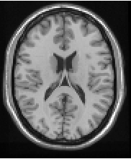
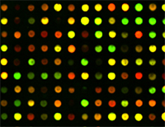
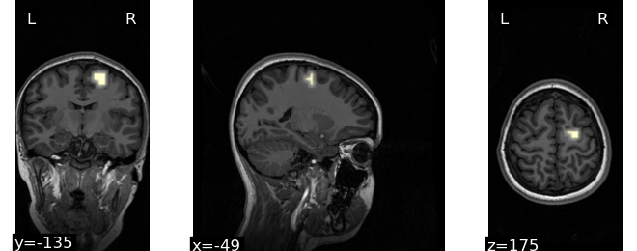
ABrain
Brain image
Genetic data
p(
,
)
finding associations:
q~10⁵⁻⁶
p~10⁶
Y
X
– Anatomical MRI
– Functional MRI
– Diffusion MRI
– DNA array (SNP/CNV)
– gene expression data
– others...
N~2000

Slide 13
Application Performance – Computation Time
Repeated a run of ABrain 1440 times on each machine
(Operations on large matrices)
Evaluate only the local resources
(CPU, Memory, Local storage)

Slide 14
Computation Variability vs. Fairness
Multitenancy model
Variability of a VM sharing a node with others with respect to an isolated one

Slide 15
Data Transfer Throughput
TCP
default and most commonly used
reliable transfer mechanism of data between VM instances
RPC
based on HTTP
used by many applications as communication paradigm between their distributed entities

Slide 16
Application Performance – Data Transfers
Delivered TCP throughput at application level

Slide 17
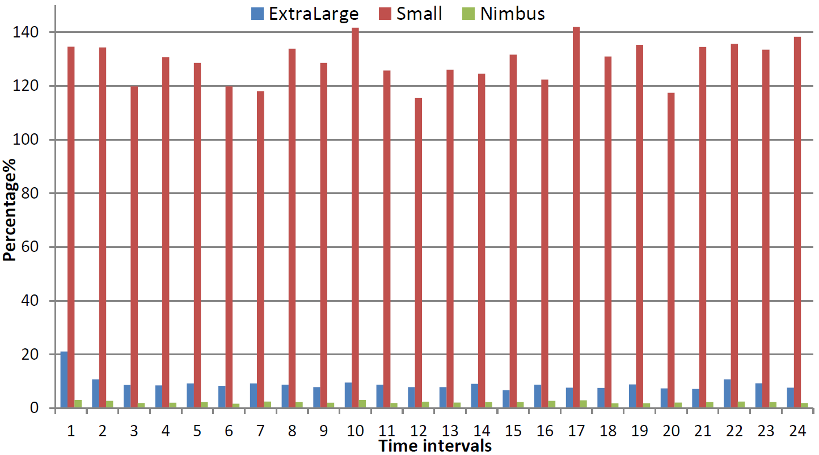
Application Performance – Data Transfers
RPC (HTTP) – delivered throughput at application level
HTTP traffic control on nodes
$$cv=\frac{std}{mean}\%$$
Notes:
RPC – actually HTTP - appears not to do so well in Azure
Proves that exists limitations on HTTP traffic for fairness reasons

Slide 18
Cost Analysis
Although scientists usually don’t pay for the private infrastructures that they access – these are not free
Hard to compute for private infrastructures
Direct for public clouds
$Costinfrastructure=\frac{15000000}{3 ∗ 24 ∗ 365 ∗ 0,85 ∗ 7469}$ euros/hour (=0.0899)
$Costelectricity=p∗Praw∗PUE$ euros/hour (=0.0086) (p=0.11 ; $Praw=0.049 ; PUE=1.7$)
Cost _{private} = 0.0985 Azure: 13.5%
Cost _{public} = 0.0852 CHEAPER
Notes:
p – electricity cost euros/kWh
Praw – energy consumption of one core per hour kWh -Wang
PUE – metric for measuring the efficiency of power distribution of equipment - Hamilton’s parameter

Slide 19
Conclusions
Compared Nimbus and Azure clouds from the point of view of scientific applications stages
Azure
- lower cost
- good TCP throughput and stability
- faster transfer from storage to VM
Nimbus
- additional control
- good RPC (HTTP) throughput
- in general better data staging
An analysis of how multitenancy model affects the fairness in public clouds
Notes:
Nimbus data staging due to proximity
Nimbus data staging is more sensible since CUMULUS is an API, hence we can chose whatever storage feats best the application needs (S3, NFS, BlobSeer, Local)

Slide 20
thank you!
Luc Bougé
Gabriel Antoniu
A Performance Evaluation of Azure and Nimbus Clouds for Scientific Applications
Alexandru Costan
Radu Tudoran

